Slide 1
OpenWorld 2017
Best Practices for Troubleshooting Oracle Business Intelligence
Moustafa Morssy
Principle Technical Support Engineer
Oracle Global Customer Support
October 3, 2017

Slide 2
Program Agenda
1
Login Problems
Troubleshooting Stuck Threads or Hangs
OBIEE Component Crash
2
3
Notes:
Today I will talk about the most important topics for customer to troubleshoot the OBIEE
From my experience I noticed these topics form a biggest percentage of SR that customer filed against Oracle Support

Slide 3
Program Agenda with Highlight
1
Login Problems
Troubleshooting Stuck Threads or Hangs
OBIEE Component Crash
2
3

Slide 4
Login Problems
Need to clarify the Following First
  Authentication
The process of granting an authenticated user access to a resource in accordance to their assigned privileges
  Authentication Provider
A security provider used to access user and group information and responsible for authenticating users. Oracle Business Intelligence default authentication provider is Oracle WebLogic Server embedded directory server and is named DefaultAuthenticator.
  Credential Store Provider
The credential store is used to store and manage credentials securely that are used internally between Oracle Business Intelligence components. For example, SSL certificates are stored here.

Slide 5
Login Problems
Identity Store Provider
  An identity store contains user name, password, and group membership information. In Oracle Business Intelligence, the identity store is typically a directory server and is what an authentication provider accesses during the authentication process. For example, when a user name and password combination is entered at log in, the authentication provider searches the identity store to verify the credentials provided. Oracle Business Intelligence can be re-configured to use alternative identity stores,

Slide 6
Login Problems
Comparing the Oracle Business Intelligence 11g and 12c
  Security Models
  The Oracle Business Intelligence Release 11g and Release 12c security models differ in the following ways:
BI System User - in Oracle Business Intelligence 11g a BI System User was used for inter-process communication and when impersonating BI users. In Oracle Business Intelligence 12c internal trust mechanisms replace this functionality and the BI System User is no longer required or provisioned.
Application security policies - In Oracle Business Intelligence 11g a default BI installation provisioned a default security policy in a file. Oracle Business Intelligence 12c uses a database policy store and the active security policy is imported from a BI Application Archive file or amended directly in the service instance.
Permissions and permission sets - in 11g the policy store specifies permissions which are (typically) assigned to application roles. In 12c a collection of Permission Sets have been added to collect together

Slide 7
Login Problems
Permissions that are typically assigned together as an entitlement. Permissions are still available, but in 12c Permission Sets are the preferred unit for assigning permissions to application roles.
4. User GUIDs - in Oracle Business Intelligence 11g user GUIDs were referenced at login and for security lookups in order to prevent inadvertent re-use of User Ids. In Oracle Business Intelligence 12c the user GUIDs are no longer referenced. Instead a cleaner approach to deleting a user from BI has been introduced.

Slide 8
Login Problems
The following aspects of the Oracle Business Intelligence Release 11g
security model remain in Release 12c:
  Oracle BI Server Initialization Blocks – The BI Server in Release 12c continues to support the use of initialization blocks for authentication and authorization. In Release 12c Oracle Business Intelligence falls back to use initialization blocks if the user cannot be authenticated by the installation's configured authentication provider
  SA System Subject Area – Oracle Business Intelligence Release 12c supports the use of SA System Subject Area, in combination with the BI Server initialization blocks,to access user, group and profile information stored in database tables.

Slide 9
Login Problems
Identifying Causes of User Login Authentication Failure
E Authenticator Misconfigured
E only one user affected
Ensure the correct, Oracle BI Certified Authenticator is configured for the identity Store
Ensure users are visible in Weblogic Admin Console
Ensure Credentials are correct
Ensure groups are visible in Weblogic Admin Console
Ensure user account not locked or expired
Ensure a user with appropriate permissions can log in to Weblogic Admin Console
Ensure ordering and control flags are correct on Authenticator

Slide 10
Login Problems
Still Unable to login? See ‘Causes of user Login Failure’ Part2
Ensure account used for LDAP connection has sufficient privileges
Ensure users and group Base DNs are correct
Ensure all JEE application are running
Ensure ‘From Name Filter’ queries are correct
Ensure all Oracle BI System Processes are Running
Ensure the attributes specified match what is in your LDAP Store
Ensure identity store is available
Ensure Weblogic Admin user is correctly moved to LDAP
Ensure weblogic has been re-started after any config changes
Authenticator Misconfigured
(Second-evel issues)
Communication failure

Slide 11
Login Problems
Oracle Web Services Manager Errors
Ensure that the database connects to the MDS-OWSM schema created on install
Ensure the OracleSystemUser account that OWSM uses to access it’s resources is working
Still Unable to login? Contact Oracle Support
Ensure that in Oracle BI 11.1.1.3 the authentication provider is the first control flag in the list of providers
Ensure that in Oracle BI 11.1.1.5(or higher) Virtualization is set to true and control flag are set in Oracle BI 11.1.1.3(see note above)
Ensure that in Oracle BI 11.1.1.5 and later if virtualize is set to true and the underlying identity Store requires SSL, check libOVD is Configured
Ensure that attribute specified for user name is set to something other than the default for the weblogic authenticator
Ensure that If SQl Authenticator Or BISQLGroup Provider Adapters configured correctly
Ensure that weblogic Server is restarted after any configuration changes
Identity Store Provider OPSS Misconfigured

Slide 12
Program Agenda with Highlight
1
Login Problems
Troubleshooting Stuck Threads or Hangs
OBIEE Component Crash
2
3

Slide 13
Troubleshooting Stuck Threads or Hangs
What are stuck threads?
  WebLogic Server diagnoses a thread as stuck if it is continually working (not idle) for a set period of time.
  WebLogic Server automatically detects when a thread in an execute queue becomes “stuck.” Because a stuck thread cannot complete its current work or accept new work, the server logs a message each time it diagnoses a stuck thread
How to check for stuck threads?
Using the Weblogic Console
Using Log Files

Slide 14
Using the Weblogic Console
One method is to use the Weblogic Console, which can be accessed using this url: http://<machine_name>:portNumber/console
portNumber is the default port. If you Weblogic server is running on a different port please substitute the port number in the url above
1. Expand the Servers node in the left pane to display the servers configured in your domain.
2. Click the name of your BI Server instance that you want to check for stuck threads.
3. Select the Monitoring Tab and then select the Threads tab.
It will display tables showing the current thread activity for the server in question:

Slide 15
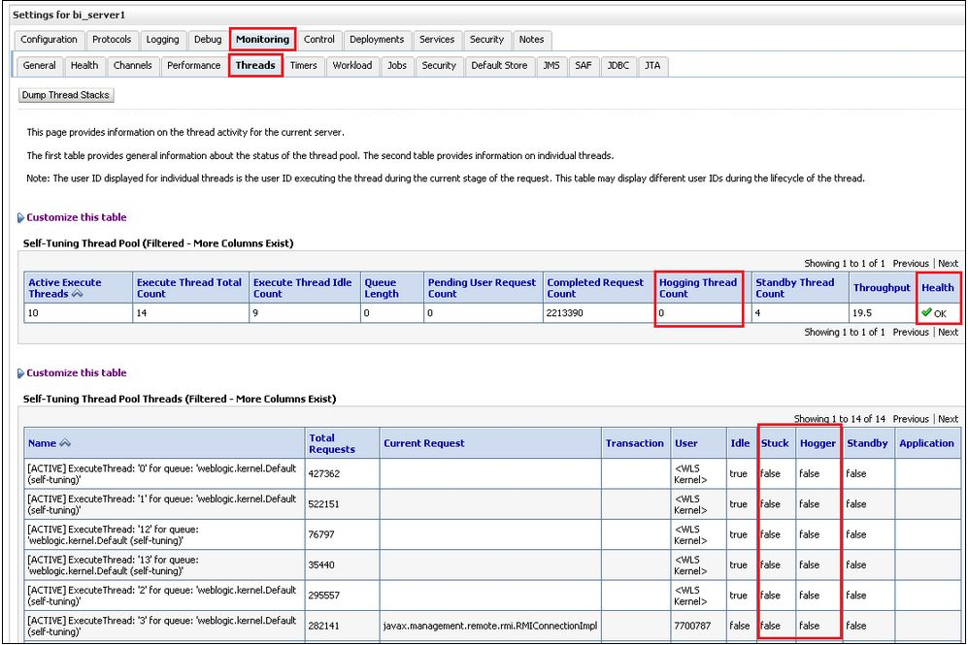
Using the Weblogic Console

Slide 16
2- Using Log Files
Another method to check for stuck threads is to look for the stuck thread message in the Managed Server log file(s).
  List of useful log files and their locations:
  Managed server log files: [MW_HOME]\user_projects\domains\bifoundation_domain\servers\bi_server1\logs
  $Oracle_Home/user_projects/domains/bi1/servers/bi_server1/logs
  BI Server log files: [MW_HOME]\instances\instance1\diagnostics\logs\OracleBIServerComponent\coreapplication_obis1
  $ Oracle_Home/user_projects/domains/bi1/servers/obis1/logs
  Admin Server log files: [MW_HOME]\user_projects\domains\bifoundation_domain\servers\AdminServer\logs

Slide 17
2- Using Log Files
  Scheduler Server log files: [MW_HOME]\instances\instance1\diagnostics\logs\OracleBISchedulerComponent\coreapplication_obisch1
  $Oracle_Home/user_projects/domains/bi1/servers/obisch1/logs
  Presentation Server log files: [MW_HOME]\instances\instance1\diagnostics\logs\OracleBIPresentationServicesComponent\coreapplication_obips1
  $Oracle_Home/user_projects/domains/bi1/servers/obips1/logs
  JavaHost log files: [MW_HOME]\instances\instance1\diagnostics\logs\OracleBIJavaHostComponent\coreapplication_obijh1

Slide 18
2- Using Log Files
  $Oracle_Home/user_projects/domains/bi1/servers/obijh1/logs
  Oracle HTTP log files (if used): [MW_HOME]\instances\instance1\diagnostics\logs\OHS\ohs1
  Oracle_Home/user_projects/domains/bi1/servers/ohs_1/logs

Slide 19
Troubleshooting Stuck Threads
Tools to troubleshoot a stuck thread
  Observe Metrics
  Collect Logs
  Weblogic Thread dump
  Use pstack or Equivalent to Capture the State of a Running Process
  Use NQCMD to test BI Server with logical SQL from an analysis

Slide 20
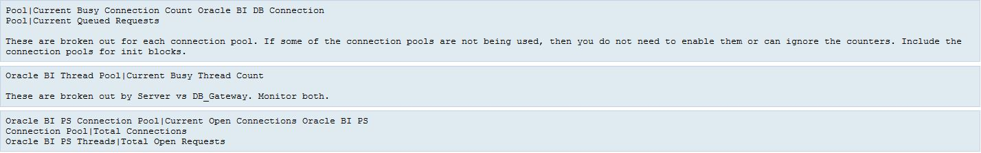
  Observe Metrics
Using Fusion Middleware Control
Expand 'Business Intelligence' in the left pane
Right-click on 'coreapplication' -> 'Monitoring' -> 'Performance' -> 'Show Metric Pallette'

Slide 21
Observe Metrics
The above are general metrics about the Presentation Server communicating with the BI Server and the BI Server with the datasources.
Some of the above metrics can also be viewed via the Perfmon URL (i.e. - http://server.domain:managedserverport/analytics/saw.dll?Perfmon or via command-line. For more details refer to the following document: How To Access OBIEE 11g Metrics Via A Command-Line
There are also other metrics that can be useful to observe, such as:
  Oracle BI LDAP Authentication
  Oracle BI PS Sessions
  Weblogic BI Security Metrics | Requests (per minute)
  DMS Metrics: http://server.domain:adminport/dms | JDBC_Connection | weblogic.management.runtime.JDBCConnectionPoolRuntimeMBean

Slide 22
Collect Logs
Collecting the relevant log files will help to isolate where the issue may be if you need to trace a transaction.
List of useful log files and their locations:
  Managed server log files: [MW_HOME]\user_projects\domains\bifoundation_domain\servers\bi_server1\logs
  BI Server log files: [MW_HOME]\instances\instance1\diagnostics\logs\OracleBIServerComponent\coreapplication_obis1
  Admin Server log files: [MW_HOME]\user_projects\domains\bifoundation_domain\servers\AdminServer\logs
  Scheduler Server log files: [MW_HOME]\instances\instance1\diagnostics\logs\OracleBISchedulerComponent\coreapplication_obisch1
  Presentation Server log files: [MW_HOME]\instances\instance1\diagnostics\logs\OracleBIPresentationServicesComponent\coreapplication_obips1
  JavaH
  Oracle HTTP log files (if used): [MW_HOME]\instances\instance1\diagnostics\logs\OHS\ohs1
  Note: If using a scaled-out environment or a cluster is installed then collect the logs from each node accordingly.ost log files: [MW_HOME]\instances\instance1\diagnostics\logs\OracleBIJavaHostComponent\coreapplication_obijh1

Slide 23
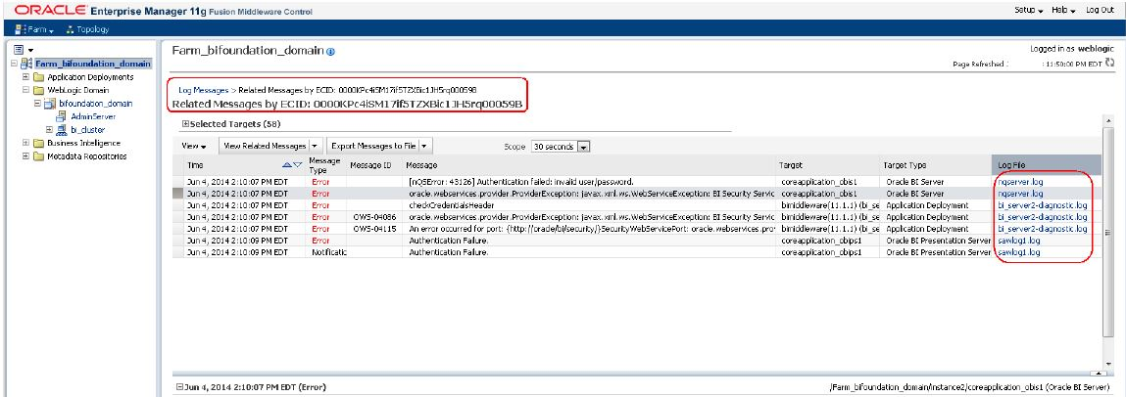
Collect Logs
  For further instructions on how to gather this information please refer to the following document: SRDC - Collecting Diagnostic Information for an OBIEE 11g Stuck Threads or Hang Issue
  If you find a Stuck Thread message in the Managed Server log file, you can then trace the ECID through the rest of the logs to trace the transaction. For details on how to trace the ECID please refer to the following document: OBIEE 11g: Using Execution Context ID (ECID ) to Assist with Troubleshooting

Slide 24
Weblogic Thread dumps
Weblogic Thread dumps can be another useful tool in helping to identify the problem thread. However, the thread is usually identified and evident in the Managed Server log file(s).
For more information on how to do this please refer to the following document: Different ways to take thread dumps in WebLogic Server

Slide 25
Use pstack or equivalent to capture the state of a running process
Using something like pstack can help determine if the processes are hanging and waiting for a response and isolate where the hang/issue may be.
Run pstack on the Presentation Server (sawserver) and the BI Server (nqsserver) for 10 minutes at 1 minute intervals.
For example, the Presentation Server from the BI Server and/or the BI Server from a datasource.

Slide 26
Tips to help avoid stuck threads
OBIEE 11g | 12c: Architectural Deployment Capacity Planning Guide (Doc ID 1323646.1)
OBIEE: Load Testing OBIEE Using Oracle Load Testing (OLT) 12.x (Doc ID 1611188.1)
OBIEE 11g Infrastructure Performance Tuning Guide (Doc ID 1333049.1)
OBIEE 12c: Best Practices Guide for Infrastructure Tuning Oracle® Business Intelligence Enterprise Edition 12c (12.2.1) (Doc ID 2106183.1)

Slide 27
Examples of stuck thread issues
The following is a list of some stuck thread issues we have encountered and their solutions:
Tuning Issues:
OBIEE 11g Users Are Unable to Login Until The BI Server Is Restarted Due to Stuck Thread Issue
Symptoms :-
When trying to log into OBIEE, you cannot login. In Oracle Enterprise Manager or via the logs, you notice thread pool stack errors:
'Threadpool -- Threadpool has stuck threads‘
nqserver log has errors like:
[2012-12-11T12:47:37.000+00:00] [OracleBIServerComponent] [ERROR:1] [] [] [ecid: 562827ca93c839f0:70501866:13b8599bb72:-8000-00000000000229dd] [tid: 45563940] [53003] LDAP bind failure: Can't contact LDAP server.

Slide 28
Examples of stuck thread issues
Cause
Connection pools were not large enough for the capacity. Tuning issue.
Solution
Tune the JDBC connection pools
Please see - OBIEE 11g Infrastructure Performance Tuning Guide (Note 1333049.1)
2.2.1 Tuning JDBC Data Sources
2.2.1.1 Increase the Number of Connection Pool
Increase the max connections in the RPD physical model connection pools.
Especially the connection pool(s) used by the authentication init blocks

Slide 29
Examples of stuck thread issues
OBIEE 11g: Error: "BEA-000337> [STUCK] ExecuteThread: '7' for queue: 'weblogic.kernel.Default (self-tuning)' has been busy for "1,276" seconds working on the request" and BI Server Crashes
Symptoms
Often you suffer very slow performance or BI Server crashes. To recover the system, you must re-start WebLogic Server, OPMN and then all the BI services
If you examine bi_server1.log file, you see an error like the following repeating:
<Aug 18, 2012 11:49:53 AM EDT> <Error> <WebLogicServer> <CATL0AS461> <bi_server1> <[STANDBY] ExecuteThread: '2' for queue: 'weblogic.kernel.Default (self-tuning)'> <<WLS Kernel>> <> <145c494ec18dcc31:76b19d11:139338e5633:-7ff9-000000000003b49d> <1345304993019> <BEA-000337> <[STUCK] ExecuteThread: '7' for queue: 'weblogic.kernel.Default (self-tuning)' has been busy for "1,276" seconds working on the request "weblogic.servlet.internal.ServletRequestImpl@5a28b93[
GET /analytics/saw.dll?Dashboard&portalPath=%2fSHARED%2fCOXBI%2f_PORTAL%2fCOXBI HTTP/1.1

Slide 30
Examples of stuck thread issues
Cause
The maximum number connections exceed the maximum number of concurrent requests in WebLogic Server.
Solution
Increase the value of oracle.bi.presentation.sawconnect.ConnectionPool.MaxConnections=512 in bridgeconfig.properties File
In the connection pool you have to take care to set the maximum connections to the correct value. Here are some guidelines as to the values to use:
Maximum connections to the dashboards = 10% of simultaneous users multiplied by the number of requests on a dashboard. But total connections have to be less than 800.

Slide 31
Examples of stuck thread issues
For the connection pool dedicated to an initialization block it should be the number of concurrent users.
The number of connection pool should be increased according to the estimated number of concurrent users. However, be aware that increasing the allowed number of concurrent connections can potentially increase the load on the underlying database accessed by the connection pool.
Test and consult with your DBA to make sure the data source can handle the number of connections specified in the connection pool.

Slide 32
Examples of stuck thread issues
You have OBIEE 11g and you see that there are a lot of files created in the directory:
$<DOMAIN_HOME>/servers/bi_server1/adr/diag/ofm/bifoundation_domain/bi_server1/incident
by the managed server (bu_server1). Reviewing one of the files, you see the following:
Incident detected using watch rule "StuckThread":
Watch time: May 31, 2013 10:45:49 AM CEST
Watch ServerName: bi_server1
Watch RuleType: Log
Watch Rule: (SEVERITY = 'Error') AND ((MSGID = 'WL-000337') OR (MSGID = 'BEA-000337'))
Watch DomainName: bifoundation_domain
Watch Data:

Slide 33
Examples of stuck thread issues
DATE : May 31, 2013 10:45:49 AM CEST
SERVER : bi_server1
MESSAGE : [STUCK] ExecuteThread: '46' for queue: 'weblogic.kernel.Default (self-tuning)' has been busy for "603" seconds working on the request "weblogic.servlet.internal.ServletRequestImpl@4e11c74[GET /analytics/saw.dll?dashboard&PortalPath=%2Fshared%2FServizio%20Clienti%20Premium%2F_portal%2FSWAP%20Easy%20Pay HTTP/1.1
Accept: image/gif, image/x-xbitmap, image/jpeg, image/pjpeg, application/x-shockwave-flash, application/x-ms-application, application/x-ms-xbap, application/vnd.ms-xpsdocument, application/xaml+xml, application/vnd.ms-excel, application/vnd.ms-powerpoint, application/msword, */*Accept-Language: it
Cause
You have run out of available threads in WebLogic Server. This might be caused by too many security calls each time the cache refreshes.

Slide 34
Examples of stuck thread issues
Solution
1) Add more threads to WebLogic Server.
See the solution to Note 1495747.1: OBIEE 11g: Error: "<BEA-000337> <[STUCK] ExecuteThread: '7' for queue: 'weblogic.kernel.Default (self-tuning)' has been busy for "1,276" seconds working on the request" and BI Server Crashes
Follow these steps from section 41.10.1.5 - Oracle Business Intelligence Server Shows StuckThreadMaxTime Exception :
Log in to the Administration console.
Choose Oracle Business Intelligence server.
Go to Configuration, select Tuning tab and increase the Stuck Thread Max Time to a higher value like 84600 seconds (the default is 600 seconds.). This will defer the StuckThreads error from appearing in the logs. Once the editing is complete, restart Oracle BI server.

Slide 35
Examples of stuck thread issues
2) Reduce the number of security calls by making the cache refresh less frequent.
For example, add the following settings to the instanceconfig.xml:
<Cache>
<UserPopulationAccountDetailsCacheByGUID>
<CleanupFrequencyMinutes>1440</CleanupFrequencyMinutes>
<MaxAgeMinutes>1440</MaxAgeMinutes>
</UserPopulationAccountDetailsCacheByGUID>
<RoleHierarchyCache>
<CleanupFrequencyMinutes>1440</CleanupFrequencyMinutes>
<MaxAgeMinutes>1440</MaxAgeMinutes>
</RoleHierarchyCache>
</Cache>

Slide 36
Use NQCMD to test BI Server with logical SQL from an analysis
This method can help determine and isolate if the BI Server (nqsserver) is hanging when communicating with the database / datasource and remove the Presentation Server from the equation.
For more information please refer to the following document: Using nqcmd to Test and Refine the Repository

Slide 37
Program Agenda with Highlight
1
Login Problems
Troubleshooting Stuck Threads or Hangs
OBIEE Component Crash
2
3

Slide 38
OBIEE Component Crash
OBIEE 10-12c: Steps To Generate Stack Trace Output To Debug Core Dump Or Hang On Linux / Unix (Doc ID 1382369.1)
OBIEE 10g-12c: Steps To Generate An ADPlus Stack Trace To Debug A Crash OR Hang On Windows (Doc ID 958101.1)
Generate stack trace & ADPlus Stack Trace per the above notes make sure the stack trace collect all the information Open Service Request with Oracle Support.

